Slide 1
Document Object Model
Copyright © 1999 - 2016 Ellis Horowitz
DOM <number>

Slide 2
What is DOM
The Document Object Model (DOM) is a programming interface for XML documents.
  It defines the way an XML document can be accessed and manipulated
  this includes HTML documents
The XML DOM is designed to be used with any programming language and any operating system.
The DOM represents an XML file as a tree
  The documentElement is the top-level of the tree. This element has one or many childNodes that represent the branches of the tree.
Copyright © 1999 - 2016 Ellis Horowitz
DOM <number>

Slide 3
Version History
DOM Level 1 concentrates on HTML and XML document models. It contains functionality for document navigation and manipulation. See:
  http://www.w3.org/DOM/
DOM Level 2 adds a stylesheet object model to DOM Level 1, defines functionality for manipulating the style information attached to a document, and defines an event model and provides support for XML namespaces. The DOM Level 2 specification is a released W3C Recommendation, see:
  http://www.w3.org/TR/DOM-Level-2-Core/
DOM Level 3 consists of 6 different specifications
  DOM Level 3 Core, http://www.w3.org/TR/DOM-Level-3-Core/
  DOM Level 3 Load and Save, http://www.w3.org/TR/DOM-Level-3-LS/
    Allows loading content of XML document into a DOM document
  DOM Level 3 XPath, http://www.w3.org/TR/DOM-Level-3-XPath/
    Functionality to access a DOM tree using XPath
  DOM Level 3 Views and Formatting, http://www.w3.org/TR/DOM-Level-3-Views/
  DOM Level 3 Requirements, http://www.w3.org/TR/DOM-Requirements/
  DOM Level 3 Validation, http://www.w3.org/TR/DOM-Level-3-Val/
DOM Level 4 consists of 1 specification
  W3C DOM4 Core, http://www.w3.org/TR/domcore/
    Consolidates previous specifications, and moves some to HTML5
Copyright © 1999 - 2016 Ellis Horowitz
DOM <number>

Slide 4
HTML or XML files viewed as a tree - order.xml
<order id="100" date="20033112">
<customer>
<name>S Spade</name>
<address>123 main st</address>
<city>Brooklyn</city>
<zip>10012</zip>
</customer>
<orderitem id="A1002" quantity="1"/>
<orderitem id="A1007" quantity="2"/>
</order>
Document
Attributes
order.xml
Root
id
date
<order>
<customer>
<orderitem>
nodelist
id
quantity
<name> <address> <city> <zip>
DOM represents documents as a hierarchy of node objects
Some types of nodes have children
Copyright © 1999 - 2016 Ellis Horowitz
DOM <number>

Slide 5
Some Useful DOM Functions
document is the root element
document.getElementById("sample")
  Returns the one location defined by id=sample, e.g. document.getElementById("sample").style.color="rgb(“FF",“00",“00");
  assigns color red to the text
document.getElementsByTagName("font")
  returns ALL font elements, e.g.
  arrayOfDocFonts = document.getElementsByTagName("font");
innerHTML
  assigns a new value to text defined by id=counter2
  document.getElementById("counter2").innerHTML = "Number of clicks = 1";
style.left, style.color properties
  one can also assign values to CSS properties, e.g.
document.getElementById('counter1').style.left = '500px';
the following slides have more examples
Copyright © 1999 - 2016 Ellis Horowitz
DOM <number>

Slide 6
Example 1: Using DOM Functions to Alter a Page - Fading Text
<html><head>
<script language="JavaScript1.2">
hex=255 // Initial color value.
function fadetext(){
if(hex>0) { //If color is not black yet
hex-=11; // increase color darkness
document.getElementById("sample").style.color="rgb("+hex+","+hex+","+hex+")";
setTimeout("fadetext()",20); }
else hex=255 //reset hex value }
</script></head><body>
<div id="sample" style="width:100%">
<h3>John slowly faded into view</h3></div>
<button onClick="fadetext()">Fade Text</button>
</body></html>
Go to: http://cs-server.usc.edu:45678/examples.html#dom
Copyright © 1999 - 2016 Ellis Horowitz
DOM <number>

Slide 7
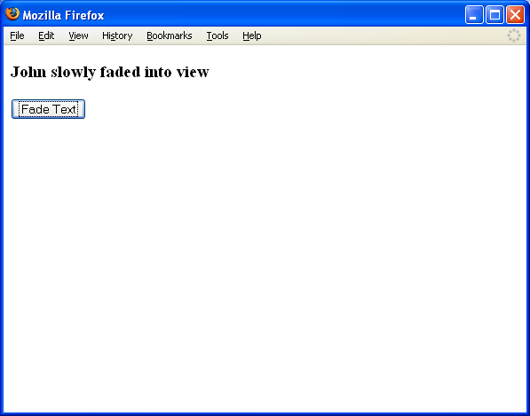
Browser Output
See http://cs-server.usc.edu:45678/examples/dom/ex1.html
Copyright © 1999 - 2016 Ellis Horowitz
DOM <number>

Slide 8
Example 2: Extracting Elements by Tag Name
<html><head>
<SCRIPT LANGUAGE="JavaScript">
function handleAllTags()
{ var arrayOfDocFonts;
if (document.all || document.getElementById)
{ arrayOfDocFonts = document.getElementsByTagName("font"); }
else { document.write("Unrecognized Browser Detected"); }
alert("Number of font tags in this document are " + arrayOfDocFonts.length + ".");
}
</SCRIPT> </head><body>
<h1><font COLOR="#0000cc">Font1</font></h1>
<h2><font COLOR="#00cc00">Font2</font></h2>
<h3><font COLOR="#cc0000">Font3</font></h3>
<h3><font COLOR="#cccccc">Font4</font></h4>
<input type=button onclick="handleAllTags()"
value="Count Font Tags">
</body></html>
Copyright © 1999 - 2016 Ellis Horowitz
DOM <number>

Slide 9
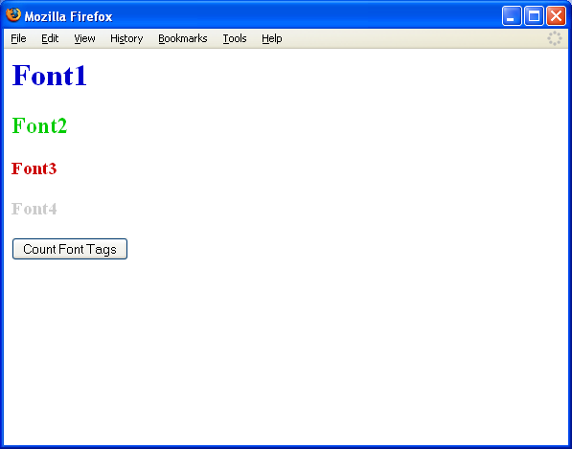
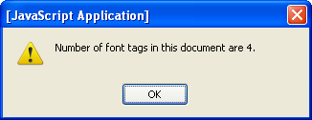
Browser Output
Copyright © 1999 - 2016 Ellis Horowitz
DOM <number>

Slide 10
innerHTML Property
The innerHTML property of elements was first devised by Microsoft
Mozilla- and Gecko-based browsers (Firefox), WebKit as well as IE decided to support it, even though it was not part of the standard
innerHTML is widely used in Ajax-based sites (see later in the course)
Elements that do not have both an opening and closing tag cannot have an innerHTML property.
The innerHTML property takes a string that specifies a valid combination of text and elements.
When the innerHTML property is set, the given string completely replaces the existing content of the object. If the string contains HTML tags, the string is parsed and formatted as it is placed into the document
Example 1: changes the color of the counter:
<DIV ID="counter2"><FONT COLOR="red">Number of clicks = 0</FONT></DIV>
This line sets the innerHTML by replacing the entire text as follows:
document.getElementById("counter2").innerHTML = "<FONT COLOR='purple'> Number of clicks = " + hits2 + "</FONT>";
innerHTML has been added to the HTML5 specification (sec. 4.11 & 7.1):
http://www.w3.org/TR/html5/infrastructure.html#dom-innerhtml
http://www.w3.org/TR/DOM-Parsing/#attributes
Copyright © 1999 - 2016 Ellis Horowitz
DOM <number>

Slide 11
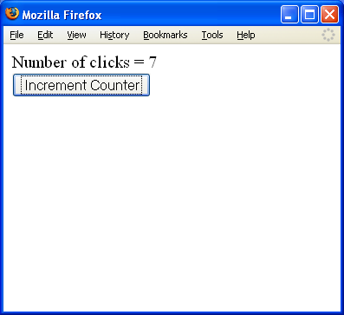
Example 3: Setting innerHTML
Example: update a counter by clicking a button
<DIV ID="counter">Number of clicks = 0</DIV>
<INPUT TYPE="button"
VALUE="Increment Counter"
onclick="updateMessage()">
<SCRIPT LANGUAGE="JavaScript">
var hits = 0;
function updateMessage() {
hits += 1;
document.getElementById("counter").innerHTML =
"Number of clicks = " + hits; }
</SCRIPT>
Copyright © 1999 - 2016 Ellis Horowitz
DOM <number>

Slide 12
Final Note on innerHTML
Suggested Rule: If you use innerHTML, don't use the += operator with innerHTML for the following reason:
  Every time innerHTML is set, the HTML has to be parsed, a DOM constructed, and inserted into the document. This takes time.
  For example, if elm.innerHTML has thousands of divs, tables, lists, images, etc, then calling .innerHTML += ... is going to cause the parser to re-parse all that stuff over again. This could also break references to already constructed DOM elements and cause other chaos. In reality, all you want to do is append a single new element to the end.
E.g. It's better to just call appendChild:
var newElement = document.createElement(’div'); newElement.innerHTML = ’<p>Hello World!</p>'; elm.appendChild(newElement);​​​​​​​​​​​​​​​​
This way, the existing contents of elm are not parsed again.
See:
https://developer.mozilla.org/en-US/docs/Web/API/Element.innerHTML
<script> elements inserted using innerHTML do not execute (HTML5):
http://www.w3.org/TR/2008/WD-html5-20080610/dom.html#innerhtml0
Copyright © 1999 - 2016 Ellis Horowitz
DOM <number>

Slide 13
Example 4: Moving Objects Horizontally
The browser-independent W3C Standard way to set and get an element's position is via the STYLE object's left and top properties
the W3C DOM Standard defines a "left", "right", "top", "bottom" properties of the style object
E.g. Moving Objects Horizontally
<INPUT ID="counter1" STYLE="position:relative; left:0px" TYPE="button" VALUE="Move Button" onclick="document.getElementById('counter1').style.left = '500px';">
E.g. Moving Objects Vertically
<INPUT ID="counter1" STYLE="position:relative; top:0px" TYPE="button" VALUE="Move Button" onclick="document.getElementById('counter1').style.top = '15px';">
Copyright © 1999 - 2016 Ellis Horowitz
DOM <number>

Slide 14
Another Example of Moving Objects on a Web Page
The following code segment adds 50 pixels to the button's left property, every time the user clicks the button:
<INPUT ID="counter1" STYLE="position:relative; left:0px" TYPE="button" VALUE="Move Button" onclick="handleClick()">
<SCRIPT LANGUAGE="JavaScript">
var obj = document.getElementById('counter1');
var xlocation = parseInt(obj.style.left); alert(xlocation);
function handleClick() { xlocation += 50; document.getElementById('counter1').style.left = xlocation + "px"; } </SCRIPT>
Copyright © 1999 - 2016 Ellis Horowitz
DOM <number>

Slide 15
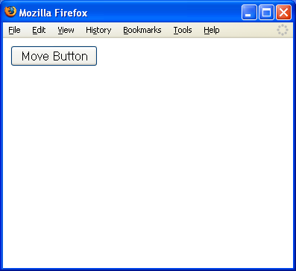
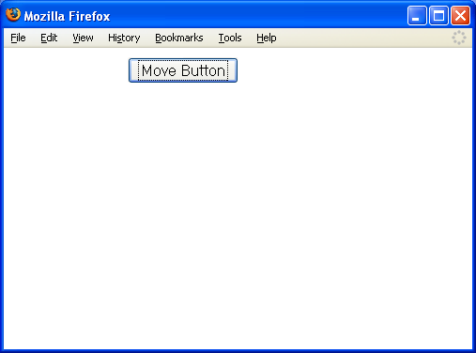
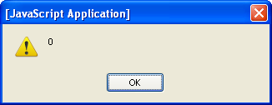
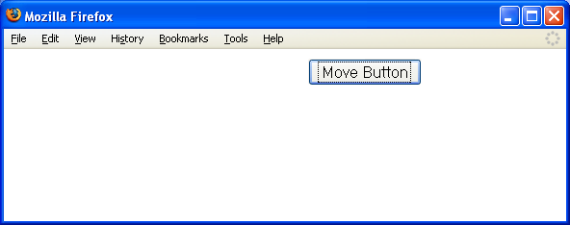
Browser Output
As the button is clicked
it moves to the right
Copyright © 1999 - 2016 Ellis Horowitz
DOM <number>

Slide 16
Example 5:Reversing the Nodes of a Document
<head><title>Reverse</title> <script>
function reverse(n)
{ // Reverse the order of the children of Node n
var kids = n.childNodes; // Get the list of children
var numkids = kids.length; // Figure out how many
children there are
for(var i = numkids-1; i >= 0; i--) { // Loop backward
through the children
var c = n.removeChild(kids[i]); // Remove a child
n.appendChild(c); // Put it back at its new position
} }
</script> </head> <body> <p>paragraph #1<p>paragraph #2<p>paragraph #3 <p>
<button onclick="reverse(document.body);" >Click Me to Reverse</button> </body>
Copyright © 1999 - 2016 Ellis Horowitz
DOM <number>

Slide 17
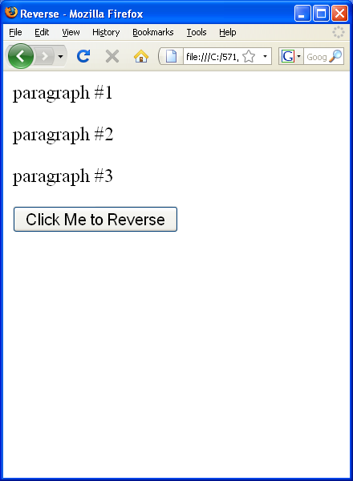
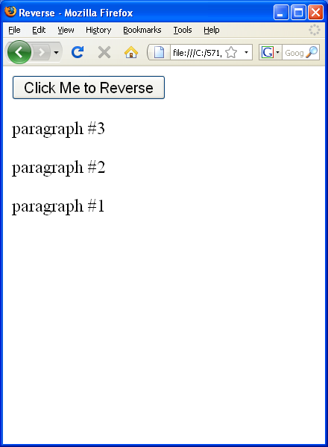
Browser Output
Copyright © 1999 - 2016 Ellis Horowitz
DOM <number>

Slide 18
DOM and Rollover Example
Rollover refers to the effect that occurs when a mouse is moved over an image and the image changes its highlighting
  To produce the effect one typically writes this:
<a href="/somewhere.html"
onmouseover="swapImage('image4', 'images/image4_over.gif');"
onmouseout="swapImage('image4', 'images/image4.gif');" >
<img src="images/image4.gif" id="image4" alt="Image" /> </a>
A DOM solution would simplify the required coding
  To produce the effect using DOM
<a href="/somewhere.html" class="rolloverLink"> <img src="images/image4.gif alt="Image" /> </a>
Copyright © 1999 - 2016 Ellis Horowitz
DOM <number>

Slide 19
DOM and Rollover Example (cont’d)
window.onload = function()
{ if (document.getElementsByTagName)
{ var allLinks = document.getElementsByTagName("a");
for (var i = 0; i < allLinks.length; i++)
{ if (allLinks[i].className == "rolloverLink")
{ allLinks[i].onmouseover = function()
{ var thisImgs = this.getElementsByTagName("img");
for (var idx = 0; idx < thisImgs.length; idx++)
thisImgs[idx].src = thisImgs[idx].src.replace('.gif', '_over.gif'); }
allLinks[i].onmouseout = function()
{ var thisImgs = this.getElementsByTagName("img");
for (var idx = 0; idx < thisImgs.length; idx++)
thisImgs[idx].src =
thisImgs[idx].src.replace('_over.gif', '.gif');
} } } } }
Assumptions
all <a> tags preceding the images have a class of "rolloverLink".
That the images have the same naming format, where the "over" state image has the same name as the regular state image except for "_over" after it.
the images are in the format of .gif.
Copyright © 1999 - 2016 Ellis Horowitz
DOM <number>

Slide 20
DOM and Rollover Example (cont’d)
Explanation
  Upon loading the function is executed
  if (document.getElementsByTagName) is a check to see if the DOM is supported
  the function compiles an array of all the <a> elements
  a "for" loop goes through each of these elements and if the class is rolloverlink, it assigns actions to the onmouseover and onmouseout handlers
  For further review go to:
  http://cs-server.usc.edu:45678/examples.html#dom
  and review the DOM Examples links, and
  http://cs-server.usc.edu:45678/resources.html
  and review the DOM tutorials
Copyright © 1999 - 2016 Ellis Horowitz
DOM <number>

Slide 21
Using a DOM Parser with Javascript
Today’s browsers include DOM parsers that can be used with JavaScript
The Microsoft XML parser is a COM component that comes with IE. Microsoft XML Core Services (MSXML) - DOM Reference found at:
  http://msdn.microsoft.com/en-us/library/ie/hh772384(v=vs.85).aspx
  The parser is activated using JavaScript, e.g. the line below creates an XML document object in Internet Explorer
  JScript: var xmlDoc = new ActiveXObject("Microsoft.XMLDOM")
Netscape-based browsers (Firefox) use a different JavaScript API:
  Javascript:
  var xmlDoc= document.implementation.createDocument("","doc",null);
Copyright © 1999 - 2016 Ellis Horowitz
DOM <number>

Slide 22
XMLHTTPRequest Object
The XMLHttpRequest object is used to exchange data with a server
With an XMLHttpRequest object you can:
  Update a web page without reloading the page
  Request data from a server after the page has loaded
  Receive data from a server after the page has loaded
  Send data to a server in the background
All modern browsers (IE7+, Firefox, Chrome, Safari, and Opera) have a built-in XMLHttpRequest object.
Syntax for creating an XMLHttpRequest object varies depending upon the browser
“Synchronous” XMLHttpRequest replaces load url/file
Copyright © 1999 - 2016 Ellis Horowitz
DOM <number>

Slide 23
Template for Loading XML into the Parser Handling Both IE and Firefox
<script type="text/javascript">
var xmlDoc;
function loadXML(url) {
if (window.XMLHttpRequest)
{// code for IE7+, Firefox, Chrome, Opera, Safari
xmlhttp=new XMLHttpRequest();
}
else
{// code for IE6, IE5
xmlhttp=new ActiveXObject("Microsoft.XMLHTTP");
}
xmlhttp.open("GET",url,false); // ‘false’ = synchronous request
xmlhttp.send(); // open, send, responseXML are
xmlDoc=xmlhttp.responseXML; // properties of XMLHTTPRequest
return xmlDoc;
}
// ....... processing the document goes here
</script>
Copyright © 1999 - 2016 Ellis Horowitz
DOM <number>

Slide 24
More Useful DOM properties
x.nodeName:
  the name of x
x.nodeValue:
  the value of x
x.parentNode:
  the parent node of x
x.childNodes:
  the child nodes of x
x.nodeType:
  the type of x
Note: x is a node object.
Copyright © 1999 - 2016 Ellis Horowitz

Slide 25
Firefox and I.E. Represent DOM Structures Differently
As a result, the node count for each is different
  You can check this by printing out document.write(x.length);
In Mozilla FF:
  all whitespace in the text content of the original document are represented in the DOM
  this does not include whitespace within tags
  some text nodes will contain only whitespace
  some text nodes will have whitespace at the beginning or end
See the article “Whitespace in the DOM” at :
https://developer.mozilla.org/en-US/docs/Web/Guide/API/DOM/Whitespace_in_the_DOM
The solutions for handling these distinctions is to check the node type
Copyright © 1999 - 2016 Ellis Horowitz

Slide 26
Node Types
Node Type | Named Constant
1 | ELEMENT_NODE
2 | ATTRIBUTE_NODE
3 | TEXT_NODE
4 | CDATA_SECTION_NODE
5 | ENTITY_REFERENCE_NODE
6 | ENTITY_NODE
7 | PROCESSING_INSTRUCTION_NODE
8 | COMMENT_NODE
9 | DOCUMENT_NODE
10 | DOCUMENT_TYPE_NODE
11 | DOCUMENT_FRAGMENT_NODE
Copyright © 1999 - 2016 Ellis Horowitz

Slide 27
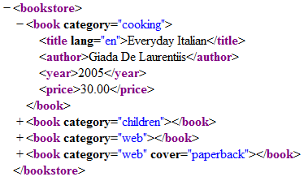
Another DOM Example
A simple XML file for a book store
Copyright © 1999 - 2016 Ellis Horowitz

Slide 28
Some Node Types in an XML File
A Sample XML File
- <bookstore>
<book category=“cooking”>
<title lang=“en”>Everyday Italian</title>
<author>Giada De Laurentiis</author>
<year>2005</year>
<price>30.00</price>
</book>
+ <book>
+ <book>
</bookstore>
Some possible node types
ELEMENT_NODE (type 1)
  bookstore, book, title, author, year, price
TEXT_NODE (type 3)
  “/n” nodes
  “Everyday Italian”, “30.00”, …
Hint:
  element nodes have children
  text nodes are leaves
x[i].nodeType == 1
  tests for element nodes.
  text nodes (like “\n”) are ignored
Copyright © 1999 - 2016 Ellis Horowitz

Slide 29
An XML Tree in Internet Explorer
bookstore
Book
Book
Book
Book
title
author
year
price
…
Everyday Italian
2005
30.00
De Laurentiis
Copyright © 1999 - 2016 Ellis Horowitz

Slide 30
The Same XML tree in FireFox
bookstore
“\n—”
Book
“\n —”
Book
“\n —”
Book
“\n —”
Book
“\n —”
“\n ——”
title
“\n ——”
author
“\n ——”
year
“\n ——”
price
…
Everyday Italian
30.00
Where — represents one space character
Copyright © 1999 - 2016 Ellis Horowitz

Slide 31
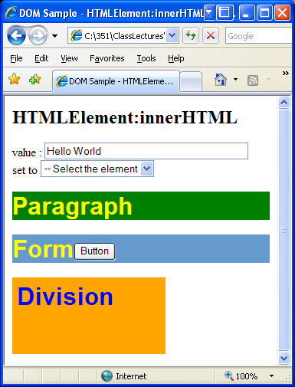
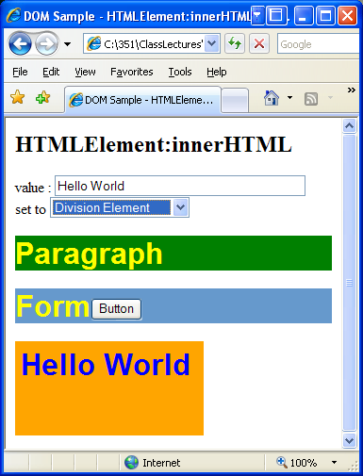
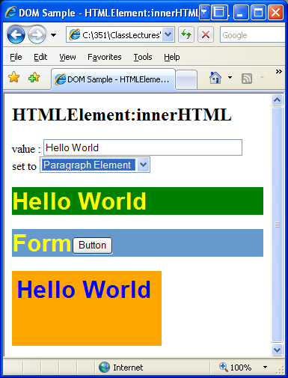
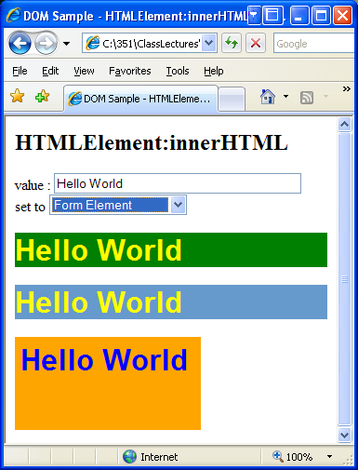
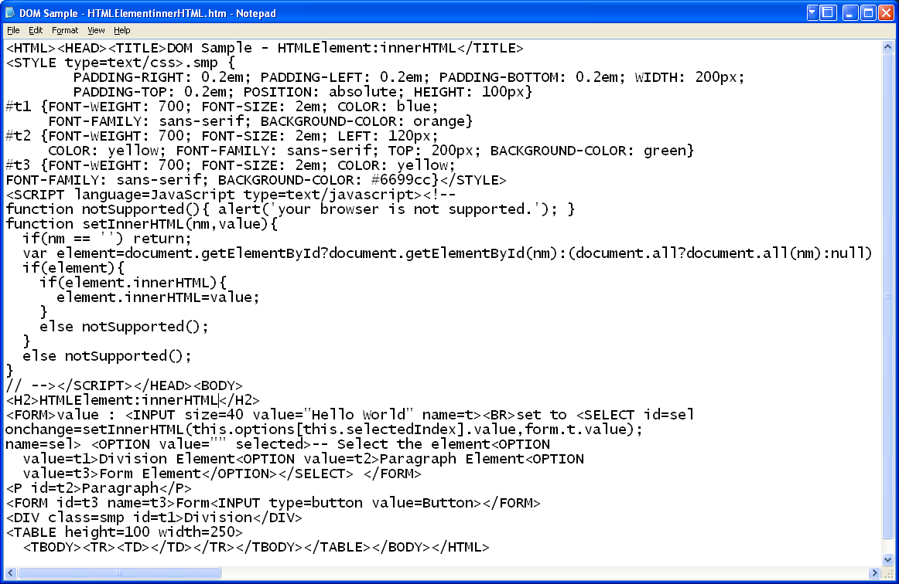
http://cs-server.usc.edu:45678/examples/dom/domtest.html
Example 6: DOM and Three InnerHTML Examples
Initial page
Select division
Select paragraph
Select form
id definitions
t1 (orange)
t2 (green)
t3 (yellow)
setInnerHTML function
defined here
3 select
options:
division,
paragraph
form
Handle selection
Copyright © 1999 - 2016 Ellis Horowitz
DOM <number>

Slide 32
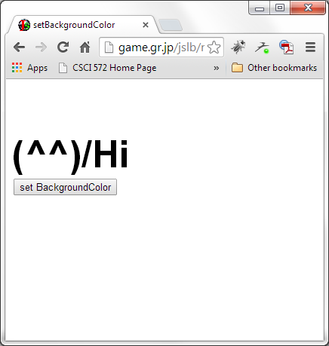
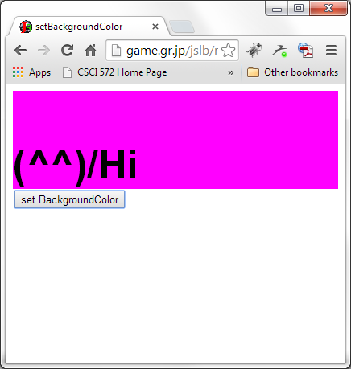
Example 7: DOM and CSS Properties – Changing Background color
before
After clicking
<HTML><HEAD><TITLE>setBackgroundColor</TITLE>
<SCRIPT TYPE="text/javascript">
<!--
function setBackgroundColor(id,bgcolor){
document.getElementById(id).style.backgroundColor = bgcolor ;
}
//-->
</SCRIPT></HEAD><BODY>
<DIV ID="test" STYLE="font:900 50px Arial"><BR>(^^)/Hi</DIV>
<FORM>
<INPUT TYPE="button"
VALUE="set BackgroundColor"
onClick="if(document.getElementById)setBackgroundColor('test','magenta')">
</FORM>
</BODY></HTML>
See all examples at: http://cs-server.usc.edu:45678/examples.html#dom
Copyright © 1999 - 2016 Ellis Horowitz
DOM <number>

Slide 33
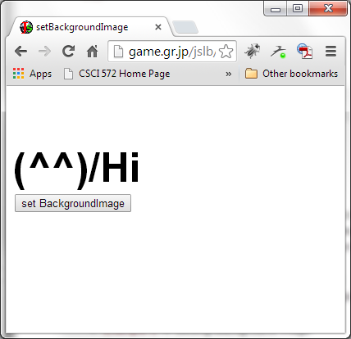
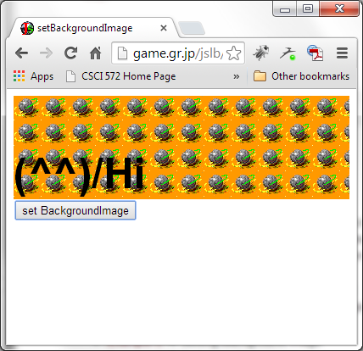
Example 8: DOM and CSS Properties – Changing Background Image
After
clicking
before
<HTML><HEAD><TITLE>setBackgroundImage</TITLE>
<SCRIPT TYPE="text/javascript">
<!--
function setBackgroundImage(id,image){
document.getElementById(id).style.backgroundImage = 'url('+image+')' ;
}
//-->
</SCRIPT>
</HEAD>
<BODY><DIV ID="test" STYLE="font:900 50px Arial"><BR>(^^)/Hi</DIV>
<FORM>
<INPUT TYPE="button"
VALUE="set BackgroundImage"
onClick="if(document.getElementById)setBackgroundImage('test','tamas.gif')">
</FORM></BODY></HTML>
Copyright © 1999 - 2016 Ellis Horowitz
DOM <number>

Slide 34
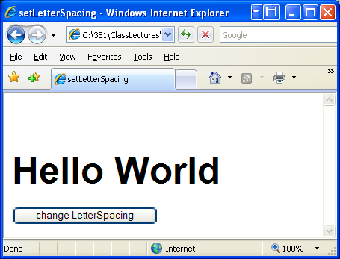
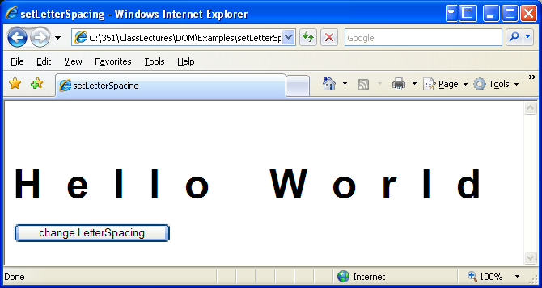
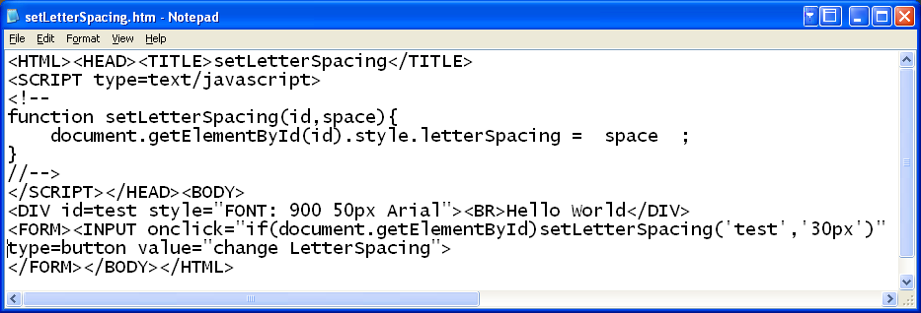
Example 10: DOM and CSS Properties – Changing Letter Spacing
before
After clicking
http://cs-server.usc.edu:45678/examples/dom/setLetterSpacing.htm
Copyright © 1999 - 2016 Ellis Horowitz
DOM <number>

Slide 35
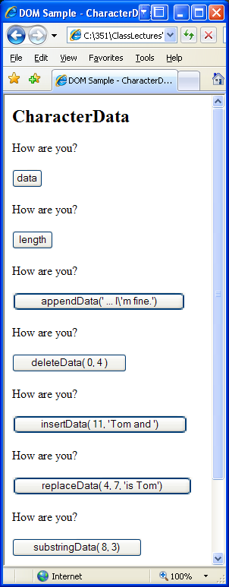
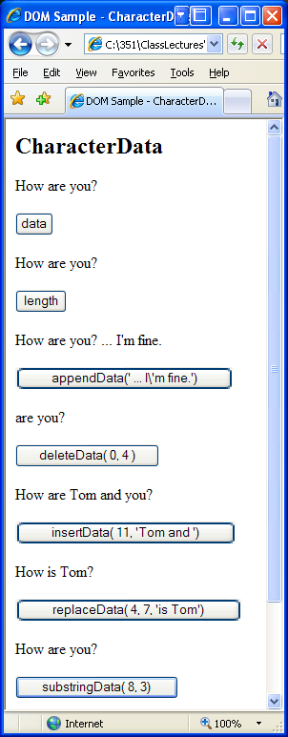
Example 11: DOM and Manipulating Character Data
Capture data in an alert box
Capture length of string in an alert box
Add text string “…I’m fine” at end of a string
Delete the first 4 characters from a string
Copyright © 1999 - 2016 Ellis Horowitz
DOM <number>

Slide 36
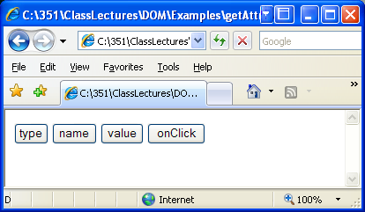
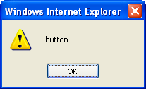
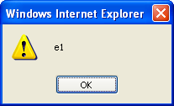

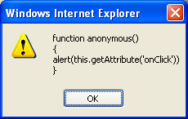
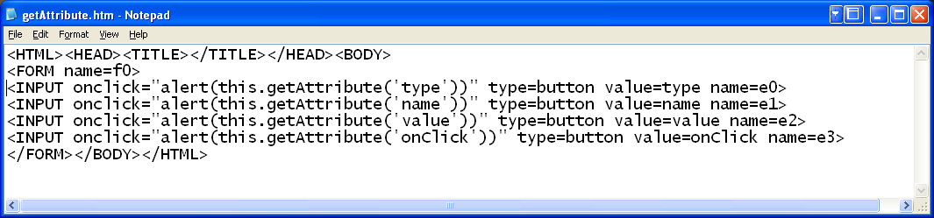
Example 12: DOM and Retrieving Attributes
type
name
value
onClick
Copyright © 1999 - 2016 Ellis Horowitz
DOM <number>

Slide 37
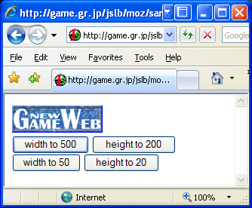
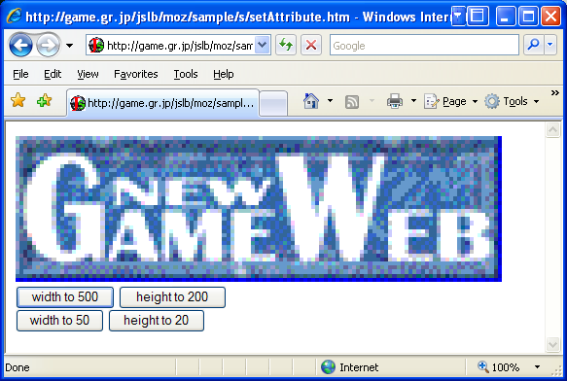
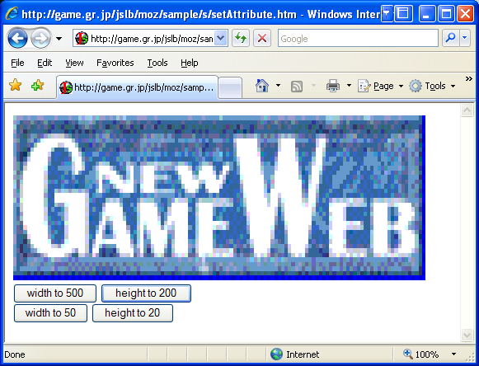
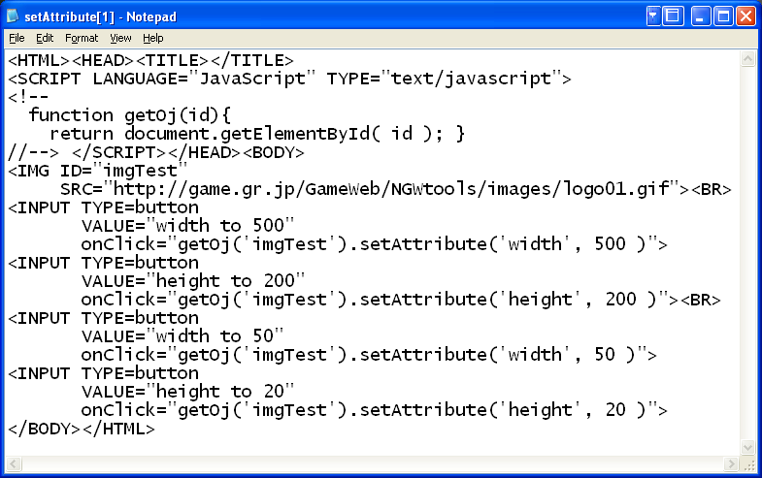
Example 13: DOM and Setting Attributes
initial
Change Width to 500
Change Height to 200
Copyright © 1999 - 2016 Ellis Horowitz
DOM <number>

Slide 38
Nodes a DOM Can Contain
An Example
<sentence> The &projectName; <![CDATA[<i>project</i>]]> is <?editor: red><bold>important</bold><?editor: normal>. </sentence>
  contains an entity ref., CDATA section, processing instructions (<?...?>
Its DOM structure looks like this:
+ ELEMENT: sentence
+ TEXT: The
+ ENTITY REF: projectName
+ COMMENT: The latest name we're using
+ TEXT: Eagle
+ CDATA: <i>project</i>
+ TEXT: is
+ PI: editor: red
+ ELEMENT: bold
+ TEXT: important
+ PI: editor: normal
Copyright © 1999 - 2016 Ellis Horowitz
DOM <number>

Slide 39
Summary of XML/HTML node types and children
Document -- Element(maximum of one), ProcessingInstruction, Comment, DocumentType (maximum of one)
DocumentFragment -- Element, ProcessingInstruction, Comment, Text, CDATASection, EntityReference
DocumentType -- no children
EntityReference -- Element, ProcessingInstruction, Comment, Text, CDATASection, EntityReference
Element -- Element, Text, Comment, ProcessingInstruction, CDATASection, EntityReference
Attr -- Text, EntityReference
ProcessingInstruction -- no children
Comment -- no children
Text -- no children
CDATASection -- no children
Entity -- Element, ProcessingInstruction, Comment, Text, CDATASection, EntityReference
Notation -- no children
Copyright © 1999 - 2016 Ellis Horowitz
DOM <number>

Slide 40
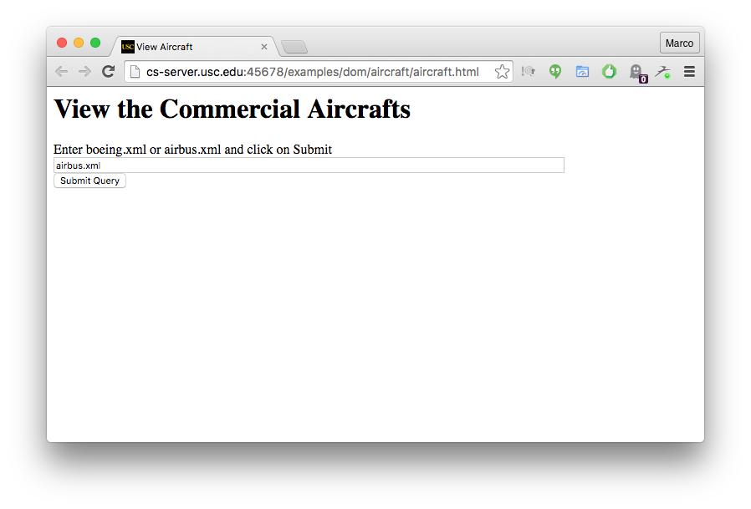
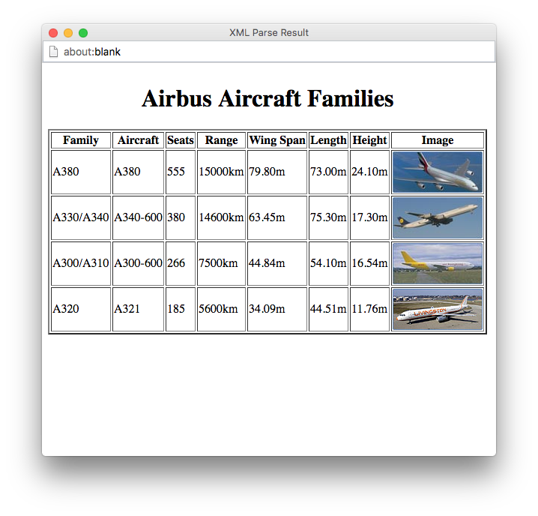
Example 14: A Longer DOM Example
Given a URL of an XML file that
describes a set of aircraft, re-format
the data into an HTML page
Copyright © 1999 - 2016 Ellis Horowitz
DOM <number>

Slide 41
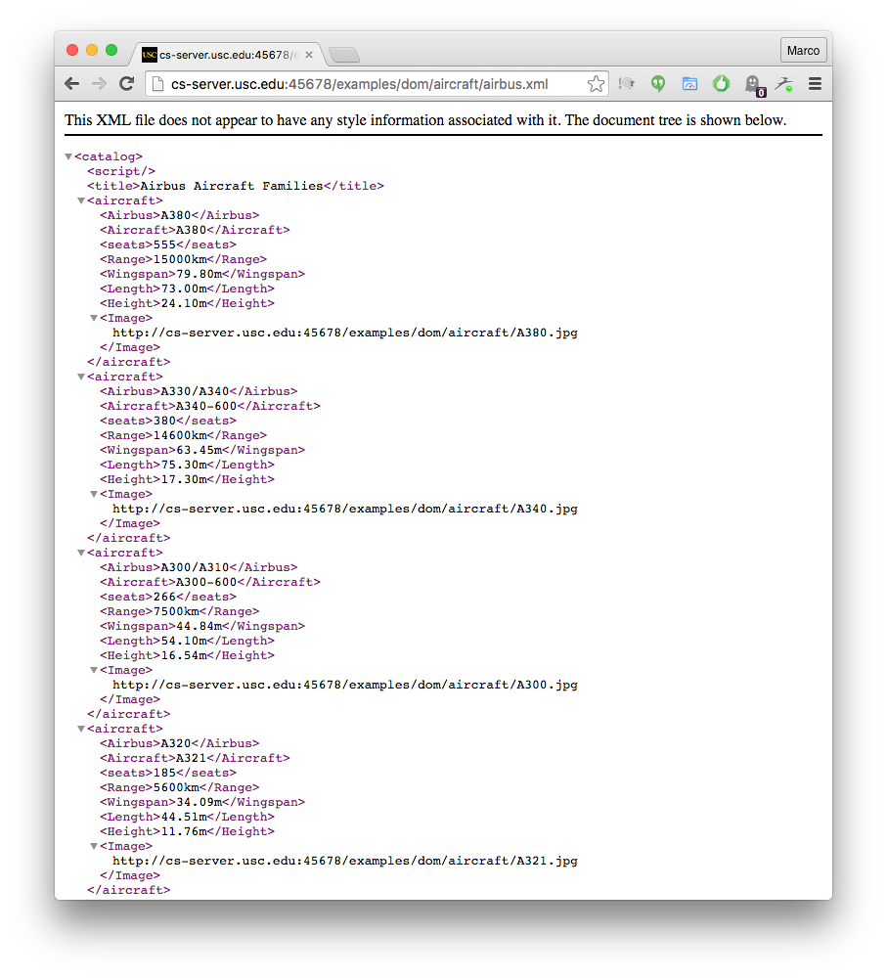
airbus.xml
Copyright © 1999 - 2016 Ellis Horowitz
DOM <number>

Slide 42
HTML Code for the Initial Input
<h1>View the Commercial Aircrafts </h1>
Enter XML file
<form name="myform" method="POST" id="location">
<input type="text" name="URL" maxlength="255" size="100" value="airbus.xml" />
<br />
<input type="button" name="submit" value="Submit Query" onClick="viewXML(this.form)" />
</form>
Copyright © 1999 - 2016 Ellis Horowitz
DOM <number>

Slide 43
viewXML Routine
function viewXML(what)
{var URL = what.URL.value;
function loadXML(url) {
if (window.XMLHttpRequest)
{// code for IE7+, Firefox, Chrome, Opera, Safari
xmlhttp=new XMLHttpRequest(); }
else {// code for IE6, IE5
xmlhttp=new ActiveXObject("Microsoft.XMLHTTP"); }
xmlhttp.open("GET",url,false);
xmlhttp.send();
xmlDoc=xmlhttp.responseXML;
return xmlDoc; }
xmlDoc = loadXML(URL);
if (window.ActiveXObject) //if IE, simply execute script (due to async prop).
{ if (xmlDoc.parseError.errorCode != 0) {
var myErr = xmlDoc.parseError;
generateError(xmlDoc);
hWin = window.open("", "Error", "height=300,width=340");
hWin.document.write(html_text);
} else { generateHTML(xmlDoc);
hWin = window.open("", "Assignment4", "height=800,width=600");
hWin.document.write(html_text); }
} else //else if FF, execute script once XML object has loaded
{ xmlDoc.onload=generateHTML(xmlDoc);
hWin = window.open("", "Assignment4", "height=800,width=600");
hWin.document.write(html_text); }
hWin.document.close(); }
Copyright © 1999 - 2016 Ellis Horowitz
DOM <number>

Slide 44
generateXML Routine
function generateHTML(xmlDoc)
{ ELEMENT_NODE = 1; // MS parser doesn't define Node.ELEMENT_NODE
root=xmlDoc.DocumentElement;
html_text="<html><head><title>XML Parse Result</title></head><body>";
html_text+="<table border='2'>";
caption=xmlDoc.getElementsByTagName("title").item(0).firstChild.nodeValue;
html_text+="<caption align='left'><h1>"+caption+"</h1></caption>";
planes=xmlDoc.getElementsByTagName("aircraft");
planeNodeList=planes.item(0).childNodes;
html_text+="<tbody>";
html_text+="<tr>";
x=0; y=0;
// output the headers
for(i=0;i<planeNodeList.length;i++)
{ if(planeNodeList.item(i).nodeType==ELEMENT_NODE)
{ header=planeNodeList.item(i).nodeName;
if(header=="Airbus")
{ header="Family"; x=120; y=55; }
if(header=="Boeing")
{ header="Family"; x=100; y=67; }
if(header=="seats")
header="Seats";
Copyright © 1999 - 2016 Ellis Horowitz
DOM <number>

Slide 45
generateXML Routine (cont’d)
if(header=="Wingspan") header="Wing Span";
if(header=="height") header="Height";
html_text+="<th>"+header+"</th>"; } }
html_text+="</tr>";
// output out the values
for(i=0;i<planes.length;i++) //do for all planes
{ planeNodeList=planes.item(i).childNodes; //get properties of a plane
html_text+="<tr>"; //start a new row of the output table
for(j=0;j<planeNodeList.length;j++)
{ if(planeNodeList.item(j).nodeType==ELEMENT_NODE)
{
if(planeNodeList.item(j).nodeName=="Image")
{//handle images separately
html_text+="<td><img src='"+planeNodeList.item(j).firstChild.nodeValue+"' width='"+x+"' height='"+y+"'></td>"; }
else {
html_text+="<td>"+planeNodeList.item(j).firstChild.nodeValue+"</td>";
} } }
html_text+="</tr>"; }
html_text+="</tbody>"; html_text+="</table>";
html_text+="</body></html>"; }
Copyright © 1999 - 2016 Ellis Horowitz
DOM <number>

Slide 46
Example 15: Another DOM Example
A simple XML file for a book store
Copyright © 1999 - 2016 Ellis Horowitz

Slide 47
Example Cont’d – function xmlparse traverses and outputs the books
function displayString(out) {
var output = document.getElementById("output");
output.innerHTML = out; }
function xmlparse() {
var html = "";
xmlDoc = loadXML("bookstore.xml");
html += ("xmlDoc is loaded, ready for use<br />");
var bookstore = xmlDoc.documentElement;
for (i=0;i< bookstore.childNodes.length ;i++)
{ var book = bookstore.childNodes[i];
if (book.nodeType==1)
{ html += ('<ul><li>');
html += ('<b>'+bookstore.childNodes[i].nodeName+' : </b>');
y = book.childNodes;
for (j=0;j<y.length;j++)
{ if (y[j].nodeType==1)
{ html += y[j].nodeName + ": "; //-> title, author etc
html += y[j].childNodes[0].nodeValue; //-> text values
html += ("<br />"); } }
html += ('</li></ul>');
} }
displayString(html); }
</script></head><body><h2>This is the domtest web page</h2>
<input type="button" name="submit" value="Submit Query“ onClick="xmlparse()" />
<noscript><div id="output"></div></body></html>
Copyright © 1999 - 2016 Ellis Horowitz
DOM <number>

Slide 48
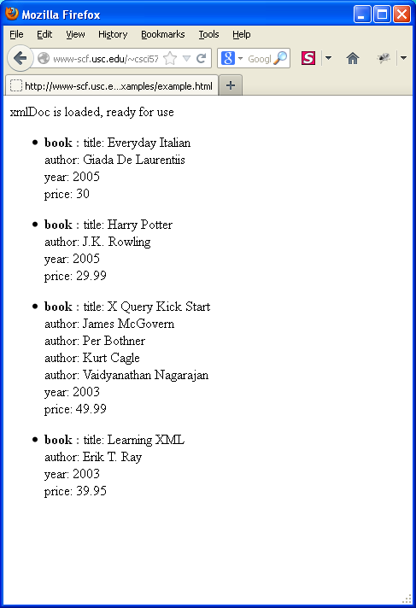
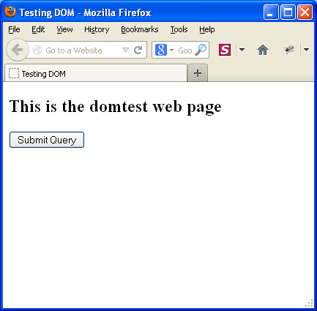
Before and After
An alternate solution that makes use of “bookstore.children” instead of
Childnodes can be found at
http://cs-server.usc.edu:45678/examples/dom/example2.html (Example 17)
Copyright © 1999 - 2016 Ellis Horowitz
DOM <number>

Slide 49
3 Different Solutions and Observations
Enter the URL and then do a View Source
  http://cs-server.usc.edu:45678/examples/dom/example_load.html
  This uses the loadXML routine shown on slide 21, employing the XMLHttpRequest object
  It works on IE7, IE8, IE9 and Firefox but not on Chrome.
Enter the URL and then do a View Source
  http://cs-server.usc.edu:45678/examples/dom/example.html
  Uses bookstore.childNodes and XMLHttpRequest
Enter the URL and then do a View Source
  http://cs-server.usc.edu:45678/examples/dom/example2.html
  Uses bookstore.children rather than bookstore.childNodes. Note that this example will not work in IE, because children is a DOM Level 4 property, and children is different in IE.
All three examples do not use document.write anymore, but the innerHTML property of an Element. document.write should be used cautiously because it prevents debuggers (Firebug, Chrome Developer Tools, Internet Explorer ToolKit)from operating fully
Key functions are: document.createElement(); and document.appendChild();, document.prependChild(); Key properties are: innerHTML, outerHTML, innerText properties to use.
When creating tables, var table = document.createElement("table"); creates a <table> Object, and var row = table.insertRow(-1); adds a row to the table (returns a <tr> object), and var tableCell = table.insertCell(-1) adds a table cell (returns a <td> object), and tableCell.innerHTML = "text";
It's better to use those functions in code for debugging rather than document.write("<tr><td>" + text + "</td></tr>");
Copyright © 1999 - 2016 Ellis Horowitz
DOM <number>

